Slide 1
CS 4530 Software Engineering
Module 14: Principles and Patterns of Cloud Infrastructure
Khoury College of Computer Sciences © 2025 released under CC BY-SA
Adeel Bhutta, Joydeep Mitra and Mitch Wand
Khoury College of Computer Sciences

Slide 2
Learning objectives for this lesson
By the end of this lesson, you should be able to…
Explain what “cloud” computing is and why it is important
Explain why shared infrastructure is important in cloud computing
Describe the difference between virtual machines and containers
Discuss trade-offs that you might consider for self or vendor-managed platforms
Notes:
<read slide>

Slide 3

How to deploy web apps?
What we need:
A server that can run our application
A network that is configured to route requests from an address to that server
Questions to think about:
What software do we need to run besides our application code? (Databases, caches, etc?)
Where does this server come from? (Buy/Borrow?)
Who else gets to use this server? (Multi-tenancy or exclusive?)
Who maintains the server and software? (Updates OS, libraries, etc?)
Notes:
* What software to run? -> Do we also need to have a database server, cache, or similar additional software that is not our app code itself, but some sort of “middleware”?
Where does this server come from? -> Do we have to buy it? Are we borrowing it?
Who else gets to use the server? -> Is this a “multi-tenant” machine, where other users also have code running on it? Or just us?
Who maintains the server and software? -> Range from physical issues (power, cooling for machine, replacing broken components) to operating system (who updates the operating system…) and maintenance of any of this middleware that we need (e.g. database)

Slide 4


Many apps rely on common infrastructure
Content delivery network: caches static content “at the edge” (e.g. cloudflare, Akamai)
Web servers: Speak HTTP, serve static content (eg REACT), load balance between app servers (e.g. haproxy, traefik)
App servers: Run our backend application (e.g. nodejs)
Misc services: Logging, monitoring, firewall
Database servers: Persistent data
Content Delivery Network
Clients
Web Servers
App Servers
Misc Services
Database servers
Notes:
(Read slide)
Examples of why we need these things:
content delivery networks (CDNs) are helpful because they are very plentiful, but “dumb” caches. “Edge” means that they are located near customers, all around the world (the “edge” of the cloud). CDNs are really good for managing high volumes of load because the load is amortized across all of the CDN’s clients. A 100x influx in traffic for our app might be a lot, but on the scale of what CloudFlare or Akamai handle all day long, it’s a drop in the bucket. Hence, these systems are also effective for protection against “denial of service” (DoS) attacks. Before cloud flare existed to provide basically a free CDN to anyone who wants it, it was not very difficult to force a web app to stop working by overwhelming it with traffic.
Web servers are the “edge” of our app, and receive HTTP(s) traffic, forwarding it on to our application, and also possibly interacting with some misc services
App servers are running our actual application. For example, our transcript server API. We might want to have multiple app servers (for scalability), so the web server in front provides an opportunity for load balancing across them
Misc services could include things like logging, monitoring, and even an application firewall (e.g. some kind of anomaly detection system that identifies potentially malicious behavior and prevents it from reaching our app)
Database servers are where we store the persistent data…

Slide 5
Render.com terminology
Content delivery network: caches static content “at the edge” (e.g. cloudflare, Akamai)
Web servers: Speak HTTP, serve static content (eg REACT), load balance between app servers (e.g. haproxy, traefik)
App servers: Run our backend application (e.g. nodejs)
Misc services: Logging, monitoring, firewall
Database servers: Persistent data
Content Delivery Network
Clients
Web Servers
"Web Service"
"Static Site"
App Servers
Misc Services
Database servers
Notes:
Since we are using render.com, we would like to know their terminology as well

Slide 6
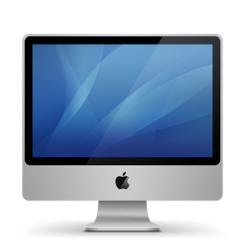
What parts of this infrastructure can be shared across different clients?
Content Delivery Network
Client 1
App 1
Web Servers
Client 2
App 2
App Servers
Misc Services
Client 3
App 3
Database servers
Notes:
How do we share the resources fairly among the different clients?
At each of these logical tiers of application infrastructure, you might consider how that tier could be shared between apps. For example, at the content delivery network level, where static files are distributed around the world and made available for fast download, you could imagine that it is fairly straightforward to put multiple applications’ files into the same storage network. At other layers, like the “application servers”, the application might require specialized resources (like system libraries, specialized hardware, etc)

Slide 7
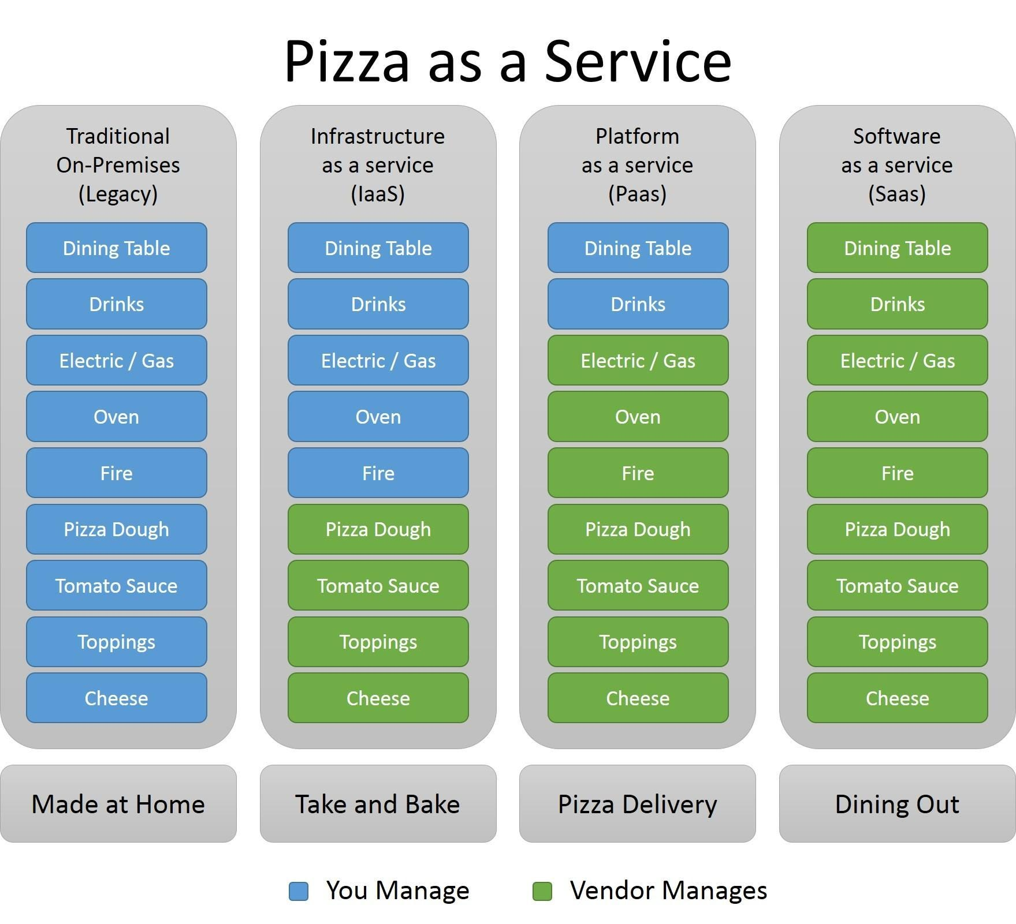
Shared infrastructure analogy: Pizza
Four ways to get pizza: Make yourself, take and bake, delivery, dine out
Vendor manages different levels of the stack, achieving economies of scale
When would you choose one over the other?
Pizza as a Service — by Albert Barron (unlicensed?)
Notes:
(read slide)
Important points that should come up when you want one over another:
Made at home: good when you have a lot of constraints and don’t want something generic. Consider: allergies, etc. Also good if you specifically want to develop the skills to dot his.
Take and bake: good when you still want to have some customization – can control how the toppings come together
Delivery: Good when you have limited human resources to do take and bake, can find a product that you are very satisfied with from a quality perspective. Likely different vendors with different tradeoffs (e.g. Dominos vs Otto/other fancier pizza places). You still have to do some of the work (if you don’t have a table to sit at, it is hard but I am sure we have all eaten pizza standing up or on the floor?)
Dining out: You pay the most, but get the most full-featured product. You can’t customize the experience anywhere near as much as if you made pizza at home, but maybe that’s a good thing?

Slide 8
Shared infrastructure creates economies of scale
At the physical level:
Multiple customers’ physical machines in the same data center
Save on physical costs (centralize power, cooling, security, maintenance)
At the physical server level:
Multiple customers’ virtual machines in the same physical machine
Save on resource costs (utilize marginal computing capacity – CPUs, RAM, disk)
At the application level:
Multiple customer’s applications hosted in same virtual machine
Save on resource overhead (eliminate redundant infrastructure like OS)
“Cloud” is the natural expansion of multi-tenancy at all levels
Notes:
Before getting into the patterns of how to use cloud infrastructure, we should discuss some of the core concepts that are provided by all cloud platforms.
One of the core concepts of cloud computing is that infrastructure is concentrated, allowing vendors operating the infrastructure to achieve economies of scale. This scale could happen at any level.
For example (read slide)
You could envision how multi-tenancy could yield significant cost savings even at a small scale: you and 5 of your buddies could rent a physical server in a data center, split the bill between yourselves, and share the resource for each of your own purposes – while saving 80% of the cost! “Cloud” is the significant expansion of multi-tenancy to otherwise unprecedented levels – hundreds of thousands of customers paying the same provider for these shared resources.

Slide 9

What is the infrastructure that can be shared?
Our apps run on a “tall stack” of dependencies
Old style: this full stack is self-managed
Cloud providers offer products that manage parts of that stack for us:
“Infrastructure as a service”
“Platform as a service”
“Software as a Service”
Collectively called “X as a Service”
Notes:
So, if we look deeper into that application, we might see that our application actually runs on a tall “stack” of different physical and logical components. Managing this all can be a full-time job for a small team!
Traditionally, this whole stack is self-managed, but there are many different infrastructure options available to us that vary the degree to which an infrastructure provider manages them for us.
The figure on the right shows the components that might make up our “stack”, and one example of what a cloud provider might provide in a model called “platform as a service.”
In a platform as a service model, the *only* thing that we provide is our application (e.g. a nodeJS app), and are not involved in the deployment or configuration of the “middleware” (like the load balancer, logging, monitoring, firewall, etc).
From the bottom up, the PaaS provider will manage:
Physical data center (need to provide power and cooling; physical security)
Network (connectivity between our servers and to the outside world)
Storage (application might have larger storage requirements than what fits on a single server, or might require shared storage)
Physical server (the “bare metal” machine, with CPUs and RAM)
Virtualization (might be running on a slice of that physical machine)
Operating system (in a PaaS model, the vendor even manages the OS, so we don’t have to think about having or needing one)
Middleware (something that interfaces with our application, beyond the operating system. An example is a load balancer for web traffic, or Kubernetes for orchestrating containers)
Application (us…)
In today’s lecture, we will discuss the different abstractions that cloud providers offer us for deployment, and the tradeoffs of those abstractions

Slide 10

Cloud services gives on-demand access to infrastructure, “as a service”
Vendor provides a service catalog of “X as a service” abstractions that provide infrastructure as a service
API allows us to provision resources on-demand
Transfers responsibility for managing the underlying infrastructure to a vendor
Notes:
However: the part of what makes it “the cloud” most, perhaps, is the ability to have *on-demand* and fully *self-service* access to resources. Those resources might be low-level abstractions (like virtual machines), or high-level abstractions (like some software, run as a service), but the key here these are “___ as a service” - the vendor provides the X as a service to us.
There are many different “as a service” abstractions that cloud providers offer (those XaaS buzzwords), and we will discuss the difference between them soon. However, what is important is that all of these abstractions can be provisioned with an on-demand self-service model. You can simply go to a web portal, pick the resource that you want (which might range from something that the vendor does little to manage, like a virtual machine, to something where the vendor does more management, like a hosted database server, or an entire application that the vendor runs for you, like a video chat server). Whatever the resource is, we have an automated approach to provision it.

Slide 11
Cloud infrastructure scales elastically
“Traditional” computing infrastructure requires capital investment
“Scaling up” means buying more hardware, or maintaining excess capacity for when scale is needed
“Scaling down” means selling hardware, or powering it off
Cloud computing scales elastically:
“Scaling up” means allocating more shared resources
“Scaling down” means releasing resources into a pool
Billed on consumption (usually per-second, per-minute or per-hour)
Notes:
Let’s contrast the traditional and cloud computing!
(Read slide)
Perhaps the most important part to understand about the “elastic” scale is that you can add more resources just for when you need them, and only pay for those resources when you are using them.
(Sidebar - Amazon EC2, and the cloud as we know it, arguably came out of Amazon’s need to have very elastic scaling of their original e-commerce business to support periods of heavy demand around holidays, black friday. Pre-EC2, it was not uncommon for stores and websites to go offline under heavy load. Amazon built a system that provided resilient scaling to their e-commerce division, then started to sell off their excess computing capacity when it wasn’t, for example, black friday, and they didn’t need it. Many “cloud” companies have similar origin stories)

Slide 12
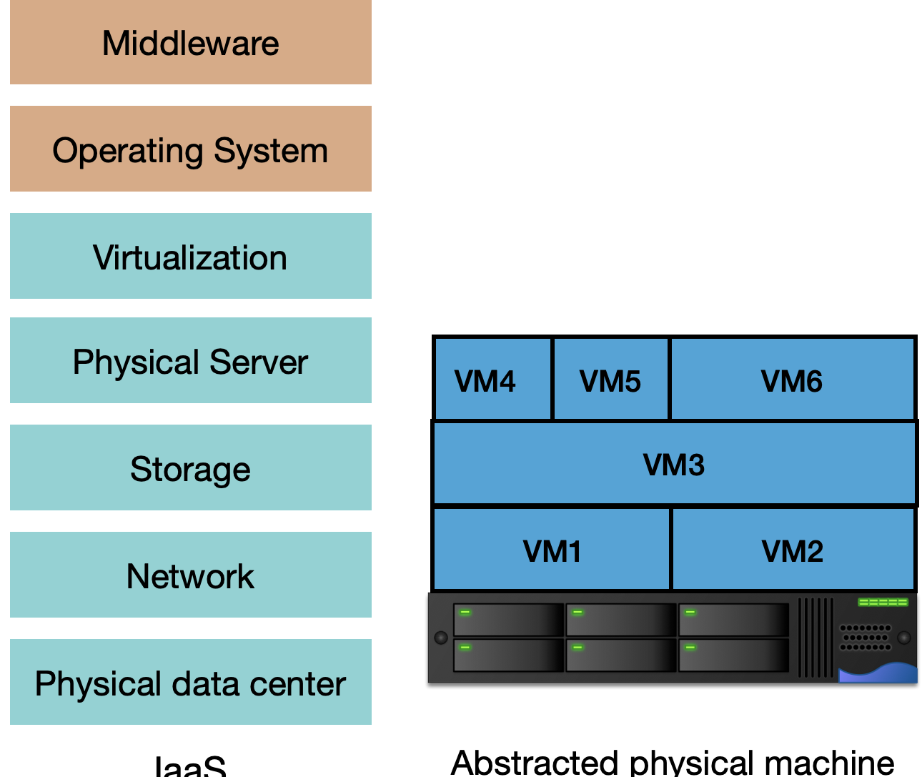
Infrastructure as a Service: Virtual Machines
Virtualize a single large server into many smaller machines
Each VM runs its own OS
OS limits resource usage and guarantees per-VM quality
Administration responsibilities separated for physical machine vs virtual machines
Examples:
Cloud: Amazon EC2, Google Compute Engine, Azure
On-Premises: VMWare, Proxmox
Notes:
One of the earliest forms of infrastructure-as-a-service provided by cloud vendors was virtualization. With virtualization, a single physical server can be split into multiple “virtual servers”, which enforce resource limits and quality guarantees per-VM. Each VM runs its own operating system, and the software running in the VM is agnostic to the fact that there is a VM instead of a physical server that runs it.
The core benefit, as shown in the diagram on the right, is that you can abstract the management of every layer *below* “Virtualization”. An engineer who maintains VMs is entirely oblivious to the layers below it – they just see their VMs, and maybe are aware which VMs are on the same physical machine. That is: in addition to benefiting from co-tenancy (which could result in better utilization of the underlying hardware), you also benefit from a reduced maintenance burden – the physical servers, storage, network, and data center can be provided by others (be it a cloud provider, or something on-prem maintained by a different team or contractor).
Although the idea of Virtualization started with IBM’s mainframe, it really became popular when Vmware introduced its x86 server called ESC Server in 2000s.

Slide 13
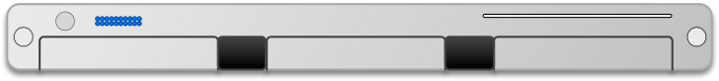
The operating system allows several apps to share the underlying hardware
The “instruction set” is an abstraction of the underlying hardware
The operating system presents the same abstraction + OS calls.
App1
App2
App1 Dependencies
App2 Dependencies
ISA+OS Calls
Operating System
ISA
Hardware
Notes:
Real hardware is immensely complicated– it’s got all kinds of registers and locks and microprogramming, which you can learn about in a computer architecture course. The “hardware layer” presents an abstraction of this underlying hardware, called the “instruction set architecture”.
The operating system presents another abstraction, typically consisting of the machine instructions (the ISA) plus a variety of system calls that operate at a higher level, such as input-output, memory management, etc.
If your app is compiled, it produces some native code from the ISA plus calls to its various dependencies.
These might be multiple apps being run by the same user (as in Windows or iOS), or apps from different users, as in old-fashioned time-sharing systems. This technology dates back to the 1960’s, if not before.

Slide 14
A virtual machine layer allows several different operating systems to share the same hardware
Virtual Machine 1
Virtual Machine 2
App1
App2
App1
App2
App1 Dependencies
App2 Dependencies
App1 Dependencies
App2 Dependencies
OS1
OS2
ISA
ISA
Virtual Machine Manager
ISA
Hardware
Notes:
A “virtual machine manager” allows multiple operating systems & their applications to share the same hardware. You might have a windows OS and a Linux OS running on the same physical machine. Virtual machines give stronger isolation guarantees than a traditional operating system offers: two VMs will, for example, have two different sets of registers.
Note that a VMM is not an emulator; it just passes through ISA instructions when it can, and dispatches results of the physical machine instructions to the registers of the appropriate virtual machine.

Slide 15
Virtual Machines facilitate multi-tenancy
Multi-Tenancy
Multiple customers sharing same physical machine, oblivious to each other
Decouples application from hardware
virtualization service can provide “live migration” transparent to the operating system, maximizing utilization
Faster to provision and release
VM v. physical machines == ~mins v. ~hours (days?)
Notes:
It is important to understand the significance of VMs in the development of cloud infrastructure.
“Multi-tenancy” is a key concept in cloud computing
While various mainframe systems have provided time-sharing (multiple users apps running on same platform), these systems often required specialized software development models, and/or did not provide the same rigid isolation that could be achieved by running those applications on separate physical machines.
VMs bring the idea of “multi-tenancy” to commodity computing. With VMs, we can have multiple customers share the same machine, oblivious to each other - each one running their own OS, and with their own guaranteed performance levels. (NB of course you could also over-provision if that was the goal…)
Asingle server can now host multiple VMs, each of which might receive a different slice of the server’s resources.
Another significant improvement of VMs over deployment directly on physical machines is resilience: the entire application (and its OS!) are now fully decoupled from the physical machine, and the virtualization service could provide a “live migration” feature, moving VMs between physical machines without any noticeable service interruption. This is a core concept that is implemented by all cloud virtualization providers, and is important to ensure that our apps can remain oblivious to hardware failures: if a component begins to fail, a VM can be migrated off of that physical machine. If a physical machine fails entirely, the VM can be restarted from another (assuming that the VM image is not lost in the failure). This also helps you maintain good resource utilization: if you have VMs running on a few different machines and are not fully utilizing them, you could consolidate them
VMs are also significantly faster to provision than physical machines. It is common for VMs to be launched within minutes of a request, whereas a request to provision (or release) a physical machine might take significantly longer.

Slide 16
Virtual Machines to Containers
Each VM contains a full operating system
What if each application could run in the same (overall) operating system? Why have multiple copies?
Advantages to smaller apps:
Faster to copy (and hence provision)
Consume less storage (base OS images are usually 3-10GB)
Notes:
(Read slide)
This problem surfaced within Google in the mid 2000’s, resulting in the development of Linux control groups (cgroups), containers, and docker
”Consume less storage” becomes a very important point for large-scale deployment of small apps. If your app itself is 10-30MB, it’s pretty lame to have to allocate 10GB of storage for it to hold ubuntu, libc, openssl, nodejs, etc. Container technology lets you share those common OS-level components.

Slide 17
Containers run layered images, reducing storage space
Images are defined programmatically as a series of “build steps” (e.g. Dockerfile)
Each step in the build becomes a “layer”
Built layers can be shared and cached
To run a container, the layers are linked together with an “overlay” filesystem
FROM node:18-buster-slim
RUN apt-get update && apt-get install python3 build-essential libpango1.0-dev libcairo2-dev libjpeg-dev libgif-dev -y
RUN mkdir -p /usr/src/app
WORKDIR /usr/src/app
COPY ./ /usr/src/app
RUN npm ci
RUN npm run build
CMD [ "npm", "start" ]
Example image specification (Dockerfile)
Our compiled app
Our app
python3, buildessential, pango, cairo, libjpeg, libgif
node:18-buster-slim
Example image, with layers shown

Slide 18
Containers run layered images, reducing storage space
Many images may share the same lower layers (e.g. OS, NodeJS, some system dependencies)
Layers are shared between images
Multi-tenancy: N running containers only require one copy of each layer (they are read-only)
Orion’s compiled app
Ripley’s compiled app
Orion’s app
Ripley’s app
python3, buildessential, pango, cairo, libjpeg, libgif
python3, buildessential, pango, cairo, libjpeg, libgif
node:18-buster-slim
node:18-buster-slim
Two images, sharing two layers
Notes:
(read slide)
A very important note is that you could be running 20 copies of the same container, and only need to store a single copy of each of the layers! Each layer is mounted “read only” in the running container through a file-system-level trick (this is called a “unionfs” in OS-parlance). Each container has its own temporary layer that it can write files to. This can DRAMATICALLY reduce storage needs – especially when there are many containers that share lower layers.

Slide 19
A container contains your apps and all their dependencies
Each application is encapsulated in a “lightweight container,” includes:
System libraries (e.g. glibc)
External dependencies (e.g. nodejs)
“Lightweight” in that container images are smaller than VM images - multi tenant containers run in the OS
Cloud providers offer “containers as a service” (Amazon AWS Fargate, Azure Kubernetes, Google Kubernetes)
Notes:
<read slide>
Kubernetes came out of Google, original internal system was called “Borg”. Automatic Deployment for multiple dockers. It allows you to declare a configuration file like this: “Give me …”. It will manage docker containers for these components on different machines. It could also share services between customers.
Paper: Large-scale cluster management at Google with Borg (2015) https://research.google/pubs/pub43438/

Slide 20
XaaS: Containers as a Service
Vendor supplies an on-demand instance of an operating system
e.g.: Linux version NN
Vendor is free to implement that instance in a way that optimizes costs across many clients.
Container 1
Container 2
App1
App2
App1
App2
App1 Dependencies
App2 Dependencies
App1 Dependencies
App2 Dependencies
ISA+OS Calls
Operating System
We don’t care what’s under here: it’s an abstraction!
ISA
Hardware

Slide 21
Docker is the prevailing container platform
Docker provides a standardized interface for your container to use
Many vendors will host your Docker container
An open standard for containers also exists (“OCI”)
Container 1
Container 2
App1
App2
App1
App2
App1 Dependencies
App2 Dependencies
App1 Dependencies
App2 Dependencies
Docker
Operating System
We don’t care what’s under here: it’s an abstraction!
ISA
Hardware
Notes:
Docker packages your app into containers.

Slide 22
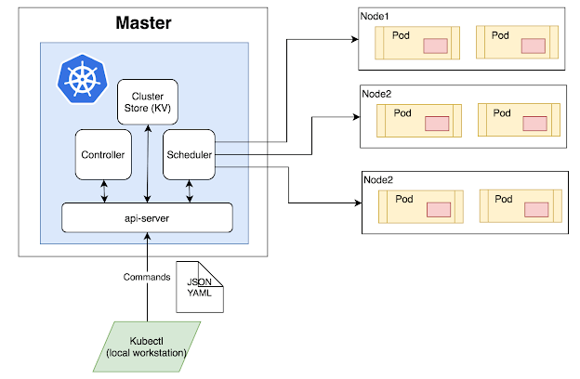
Kubernetes is an orchestration system for managing Docker containers at scale
Containers alone are lightweight but hard to manage at scale.
Kubernetes is an open-source platform for automating deployment, scaling, and management of containerized applications.
Notes:
Kubernetes: Container Orchestration for Modern Applications
An open-source platform for automating deployment, scaling, and management of containerized applications.
Originally developed by Google, now maintained by the Cloud Native Computing Foundation (CNCF).
Works with Docker and other container runtimes.
Kubernetes provides:
Automatic scaling
Load balancing
Self-healing (restarts failed containers)
Rolling updates & rollbacks
Service discovery

Slide 23
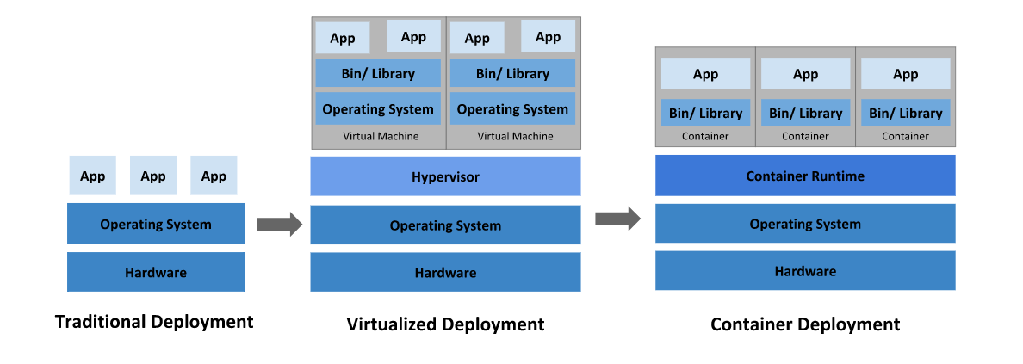
VMs and Containers
https://kubernetes.io/docs/concepts/overview/
Notes:
Conceptually, here are how things are organized in on-premises, VM vs containers.

Slide 24
Tradeoffs between VMs and Containers
Performance is comparable
Each VM has a copy of the OS and libraries
Higher resource overhead
Slower to provision
Support for wider variety of OS’s
Containers are “lightweight”
Lower resource overhead
Faster to provision
Potential for compatibility issues, especially with older software
Containers are often chosen for speed, efficiency and scalability (and cost benefits)
Notes:
(read slide)
The few cases where we would suggest choosing VMs over containers are:
Where you NEED a different operating system. It is only possible to run Linux inside of Docker – you can’t create a container that runs windows or mac.
Where there are bizzare compatibility issues. For example, if you needed to use NodeJS 8 as Prof Bell recently did, you might find that NPM 5 doesn’t work inside of Docker due to some weird bug that didn’t get fixed until later versions of NodeJS.

Slide 25
Platform-as-a-Service: vendor supplies OS + middleware
Middleware is the stuff between our app and a user’s requests:
Content delivery networks: Cache static content
Web Servers: route client requests to one of our app containers
Application server: run our handler functions in response to requests from load balancer
Monitoring/telemetry: log requests, response times and errors
Cloud vendors provide managed middleware platforms too: “Platform as a Service”
Content Delivery Network
Clients
Web Servers
App Servers
Monitoring/Telemetry
Database servers
Notes:
We’re now on the path of having the vendor manage more and more of the infrastructure your software needs.
The next logical step is for the vendor to supply some or all of your middleware. That is, rather than thinking about ”x-as-a-service” where we think about generic infrastructure (e.g. VMs as a service, containers as a service), we can go back to our picture from the beginning, and ask – how can a vendor provide each of the *functional* components of our application, like the CDN, etc. as a service – so we don’t think or care about how it’s implemented (vms, containers, etc).
<read slide>
Middleware is fussy: writing it requires expertise that your team may not have. A vendor can probably do it better than you can. And middleware can be shared across apps and clients , making it even more economical for a vendor to supply it.

Slide 26
PaaS is often the simplest choice for app deployment
Platform-as-a-Service provides components most apps need, fully managed by the vendor: load balancer, monitoring, application server
Some PaaS run your app in a container: Heroku, AWS Elastic Beanstalk, Google App Engine, Railway, Vercel…
Other PaaS run your apps as individual functions/event handlers: AWS Lambda, Google Cloud Functions, Azure Functions
Other PaaSs provide databases and authentication, and run your functions/event handlers: Google Firebase, Back4App
Application
Middleware
Operating System
Virtualization
Physical Server
Storage
Network
Physical data center
PaaS
Notes:
<read slide>
Notice that in this diagram all the client supplies is the app; the vendor provides all the other layers.
One note about systems that provide functions-as-a-service (e.g. AWS Lambda): These systems are really handy when you have some code that you need to trigger to run infrequently, and runs quickly. They bill by the millisecond. So, they can become quite expensive quite quickly if they get called a lot (or if they are slow running). Recall when we discussed asynchrony, we examined the performance of making some web requests and found that each request might take 300-500 ms to complete. PaaS platforms will still bill you for that idle waiting time!

Slide 27
PaaS in the style of Heroku runs containers
Takes a web app as input
Provide an entry point to code, e.g. “npm start”, or optionally, a container specification
Hosts web app at chosen URL, can scale resources up/down on-demand
Load balancer fully managed by Heroku, scaling transparent
Auto-scale down to use no resources, spins up container on reception of a request
Dashboard for monitoring/reporting
Newcomers provide similar functionality (Vercel, Railway, etc)
Host PaaS on-premises, too (Caprover)
HTTP requests
Load balancer + traffic monitor
Container
Container
Our NodeJS App
Our NodeJS App
Notes:
Heroku is a platform-as-a-service specialized for web apps.
(Read slide)
What is neat about Heroku’s platform is that they share the load balancing work among so many clients that the cost of the load balancer is basically free. All requests go through the load balancer. As a result, the platform can turn off your app when it’s idle, and turn it back on if it gets a request that it needs to satisfy.

Slide 28
Render.com uses a mixed strategy for implementation
Web services are run in containers on their app servers.
Load balancers, dashboards, etc. are shared by all users
Other services: eg Redis ("Software as a Service")
"Static Web Sites" are hosted as static files on their CDN.
minimizes load times for users world-wide.

Slide 29
Software as a Service adds more vendor-managed apps
Providers may also develop custom software offered only as a service
Examples:
PostgreSQL (open source)
Twilio Programmable Video (proprietary chat)
Application
Application
Middleware
Middleware
Operating System
Operating System
Virtualization
Virtualization
Physical Server
Physical Server
Storage
Storage
Network
Network
Physical data center
Physical data center
IaaS
SaaS
Self-managed
Vendor-managed
Notes:
<read slide>

Slide 30
Self-managed vs Vendor-managed Infrastructure Tradeoffs
Consider who manages each tier in the stack
Benefits to vendor-managed options:
More ways to reduce resource consumption, improve resource utilization
Less management burden
Less capital investment, more flexibility in scaling
Benefits to self-managed options:
Greater flexibility to migrate between software platforms
More capital investment, potentially less operating expense
Application
Application
Middleware
Middleware
Operating System
Operating System
Virtualization
Virtualization
Physical Server
Physical Server
Storage
Storage
Network
Network
Physical data center
Physical data center
Traditional, on-premises computing
SaaS
Self-managed
Vendor-managed
Notes:
As we have seen, there is a wide spectrum between traditional, on-premises computing, infrastructure as a service, platform as a service, and software as a service options.
(read slide)
By “Greater flexibility to migrate between software platforms,” we mean that cloud providers have a tendency to build walled gardens of services – they are relatively easy to start using, but very difficult to migrate out of. With a self-managed system, you may have a greater maintenance burden overall (e.g. to set up and manage that system!) but you can also control for migration paths. For example, if you started out using VMWare to run your VMs and storage network on-premises but wanted to migrate to the open source “proxmox,” there are automated processes to accomplish this.
By “Potentially less operating expense” we mean that you trade in a monthly cloud computing bill for:
A capital outlay to buy some equipment, possibly hundreds of thousands of dollars
A recurring expense for the humans that operate and maintain that on-prem resource.
However, we’ll see that depending on the variables at play (particularly: “do you already have someone who can manage this”, and “do you already have somewhere you can house the hardware”), this can end up being cheaper overall.

Slide 31
Cloud Infrastructure can be better for variable workloads
Consider:
Does your workload benefit from ability to scale up or down?
Variable workloads have different demands over time (most common)
Constant workloads require sustained resources (less common)
Example:
Need to run 300 VMs, each 4 vCPUs, 16GB RAM
Private cloud:
Dell PowerEdge Pricing (AMD EPYC 64 core CPUs)
7 servers, each 128 cores, 512GB RAM, 3 TB storage = $162,104
Public cloud:
Amazon EC2 Pricing (M7a.xlarge instances, $0.153/VM-hour)
10 VMs for 1 year + 290 VMs for 1 month: $45,792.90
300 VMs for 1 year: $402,084.00
Notes:
Cloud infrastructure makes sense when you expect the need to be able to scale up and down, and where the amount that you need to scale by is larger than your normal capacity needed.
For example: imagine that we are building a system that needs to be able to scale up in resources to go up to using 300 VMs, each with 4 CPUs and 16 GB RAM.
(Click) If we are buying hardware ourselves for this, we might buy something like these Dell PowerEdge servers, each with 128 cores and 512GB RAM, giving us enough capacity to scale up to 300 VMs (plus some extra CPUs + RAM for managing this whole cluster). In July 2021 this cost $162,104.
What would this cost for a year if we went to Amazon? (Click) We could get virtual machines at $0.121/hour. If our baseline infrastructure requirement was just to have 10 VMs for the year, and we projected that only at peak loads we would need to scale up (to say, another 290 VMs for 1 month), the total cost at the end of the year would be $36,215.30. We would definitely save some cash compared to the self-hosted option (plus the hassle of procuring and managing that cluster).
But: what if we needed all 300 VMs for the entire year? Using EC2 this would cost $317,988 - nearly twice the cost of the self-managed option (and it’s just for one year! Once you buy the servers they will last for hopefully quite a few years!).
Self-managing a cluster like this requires a place to put them, power, and cooling - plus the administration of the software. (this dell cluster draws up to 90 amps of power, which is roughly half of the power that typically service as a house).
(The EC2 pricing was taken on Feb 19, 2024. The pricing includes the discount that you would receive for guaranteeing a year of compute time per-VM.
Dell pricing from July 2021, includes enterprise discount for Northeastern
The astute reader will note that amazon gives you 4 “vCPUs” which means 2 physical CPU cores, each of which are hyper threaded. The 7 x 128c option gives you a few extra cores to spare)

Slide 32
Public clouds are not the only option
“Public” clouds are connected to the internet and available for anyone to use
Examples: Amazon, Azure, Google Cloud, DigitalOcean
“Private” clouds use cloud technologies with on-premises, self-managed hardware
Cost-effective when a large scale of baseline resources are needed
Example management software: OpenStack, VMWare, Proxmox, Kubernetes
“Hybrid” clouds integrate private and public (or multiple public) clouds
Effective approach to “burst” capacity from private cloud to public cloud
Notes:
As we saw on the last slide, public clouds may not be the most cost-effective option when a workload has a high baseline resource requirement - like needing to have 300 x 4 core VMs running all of the time.
(Read slide)
A “hybrid” cloud option could prefer to consume resources from our on-premises resource, only “bursting” to use public cloud services when the private cloud reaches a capacity threshold

Slide 33
“X as a Service" offers several abstractions to choose from depending on your needs
Vendor manages different levels of the stack, achieving economies of scale
When would you choose one over the other?
Explore some options at https://comparecloud.in/
Application
Application
Application
Application
Middleware
Middleware
Middleware
Middleware
Operating System
Operating System
Operating System
Operating System
Virtualization
Virtualization
Virtualization
Virtualization
Physical Server
Physical Server
Physical Server
Physical Server
Storage
Storage
Storage
Storage
Network
Network
Network
Network
Physical data center
Physical data center
Physical data center
Physical data center
Traditional, on-premises computing
IaaS
PaaS
SaaS
Self-managed
Vendor-managed
Notes:
<read slide>

Slide 34
Review
You should now be able to…
Explain what “cloud” computing is and why it is important
Explain why shared infrastructure is important in cloud computing
Describe the difference between virtual machines and containers
Discuss trade-offs that you might consider for self or vendor-managed platforms

